Slide 1
Array
Is it necessary to define an array as an ADT?
  C++ array requires the index set to be a set of consecutive integers starting at 0
  C++ does not check an array index to ensure that it belongs to the range for which the array is defined.

Slide 2
ADT 2.1 Abstract data type GeneralArray
class GeneralArray {
// objects: A set of pairs < index, value> where for each value of index in IndexSet there
// is a value of type float. IndexSet is a finite ordered set of one or more dimensions,
// for example, {0, …, n-1} for one dimension, {(0, 0), (0, 1), (0, 2),(1, 0), (1, 1), (1, 2), (2, 0),
// (2, 1), (2, 2)} for two dimensions, etc.
public:
GeneralArray(int j; RangeList list, float initValue = defatultValue);
// The constructor GeneralArray creates a j dimensional array of floats; the range of
// the kth dimension is given by the kth element of list. For each index i in the index
// set, insert <i, initValue> into the array.
float Retrieve(index i);
// if (i is in the index set of the array) return the float associated with i
// in the array; else signal an error
void Store(index i, float x);
// if (i is in the index set of the array) delete any pair of the form <i, y> present
// in the array and insert the new pair <i, x>; else signal an error.
}; // end of GeneralArray

Slide 3

ADT 2.2 Abstract Data Type Polynomial
class polynomial {
// objects: a set of ordered pairs of <e_{i}, a_{i}>
//where a_{i} Coefficient and e_{i} Exponent
// We assume that Exponent consists of integers ≥ 0
public:
Polynomial();
// return the polynomial p(x) = 0
int operator!();
// if *this is the zero polynomial, return 1; else return 0;
Coefficient Coef(Exponent e);
// return the coefficient of e in *this
Exponent LeadExp();
// return the largest exponent in *this
Polynomial Add(Polynomial poly);
// return the sum of the polynomials *this and poly
Polynomial Mult(Polynomial poly);
// return the product of the polynomials *this and poly
float Eval(float f);
// Evaluate the polynomial *this at f and return the result
}; end of Polynomial

Slide 4
Polynomial Representations
Representation 1
private:
int degree; // degree ≤ MaxDegree
float coef [MaxDegree + 1];
Representation 2
private:
int degree;
float *coef;
Polynomial::Polynomial(int d)
{
degree = d;
coef = new float [degree+1];
}
Representation 3
class Polynomial; // forward delcaration
class term {
friend Polynomial;
private:
float coef; // coefficient
int exp; // exponent
};
private:
static term termArray[MaxTerms];
static int free;
int Start, Finish;
term Polynomial:: termArray[MaxTerms];
Int Polynomial::free = 0; // location of next free location in temArray

Slide 5
Figure 2.1 Array Representation of two Polynomials
Represent the following two polynomials:
A(x) = 2x¹⁰⁰⁰ + 1
B(x) = x⁴ + 10x³ + 3x² + 1
 | A.Start | A.Finish | B.Start |  |  | B.Finish | free
coef | 2 | 1 | 1 | 10 | 3 | 1
exp | 1000 | 0 | 4 | 3 | 2 | 0
 | 0 | 1 | 2 | 3 | 4 | 5 | 6

Slide 6
Polynomial Addition
Polynomial Polynomial:: Add(Polynomial B)
// return the sum of A(x) ( in *this) and B(x)
{
Polynomial C; int a = Start; int b = B.Start; C.Start = free; float c;
while ((a <= Finish) && (b <= B.Finish))
switch (compare(termArray[a].exp, termArray[b].exp)) {
case ‘=‘:
c = termArray[a].coef +termArray[b].coef;
if ( c ) NewTerm(c, termArray[a].exp);
a++; b++;
break;
case ‘<‘:
NewTerm(termArray[b].coef, termArray[b].exp);
b++;
case ‘>’:
NewTerm(termArray[a].coef, termArray[a].exp);
a++;
} // end of switch and while
// add in remaining terms of A(x)
for (; a<= Finish; a++)
NewTerm(termArray[a].coef, termArray[a].exp);
// add in remaining terms of B(x)
for (; b<= B.Finish; b++)
NewTerm(termArray[b].coef, termArray[b].exp);
C.Finish = free – 1;
return C;
} // end of Add
O(m+n)

Slide 7
Program 2.9 Adding a new Term
void Polynomial::NewTerm(float c, int e)
// Add a new term to C(x)
{
if (free >= MaxTerms) {
cerr << “Too many terms in polynomials”<< endl;
exit();
}
termArray[free].coef = c;
termArray[free].exp = e;
free++;
} // end of NewTerm

Slide 8
Disadvantages of Representing Polynomials by Arrays
What should we do when free is going to exceed MaxTerms?
  Either quit or reused the space of unused polynomials. But costly.
If use a single array of terms for each polynomial, it may alleviate the above issue but it penalizes the performance of the program due to the need of knowing the size of a polynomial beforehand.

Slide 9
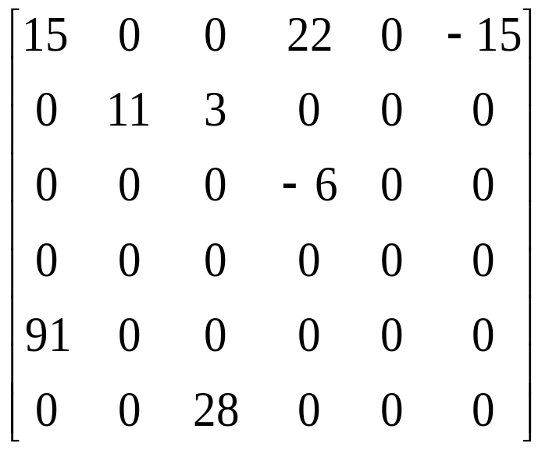
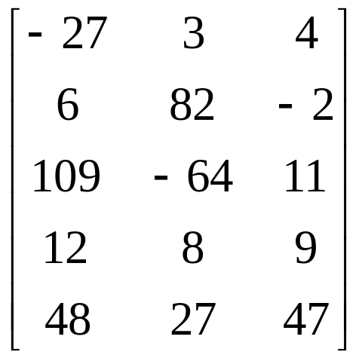
Sparse Matrices

Slide 10
ADT 2.3 Abstract data type SparseMatrix
class SparseMatrix
// objects: A set of triples, <row, column, value>, where row and column are integers and form a unique combinations; value is also an integer.
public:
SparseMatrix(int MaxRow, int MaxCol);
// the constructor function creates a SparseMatrix that can hold up to
// MaxInterms = MaxRow x MaxCol and whose maximum row size is MaxRow
// and whose maximum column size is MaxCol
SparseMatrix Transpose();
// returns the SparseMatrix obtained by interchanging the row and column value
// of every triple in *this
SparseMatrix Add(SparseMatrix b);
// if the dimensions of a (*this) and b are the same, then the matrix produced by
// adding corresponding items, namely those with identical row and column
// values is returned
// else error.
SparseMatrix Multiply(SparseMatrix b);
// if number of columns in a (*this) equals number of rows in b then the matrix d
// produced by multiplying a by b according to the formula d[i][j] =
// Σ(a[i][k] . b[k][j]), where d[i][j] is the (i, j)th element, is returned. k ranges from 0
// to the number of columns in a – 1
// else error
};

Slide 11
Sparse Matrix Representation
Use triple <row, column, value>
Store triples row by row
For all triples within a row, their column indices are in ascending order.
Must know the number of rows and columns and the number of nonzero elements

Slide 12
Sparse Matrix Representation (Cont.)
class SparseMatrix; // forward declaration
class MatrixTerm {
friend class SparseMatrix
private:
int row, col, value;
};
In class SparseMatrix:
private:
int Rows, Cols, Terms;
MatrixTerm smArray[MaxTerms];

Slide 13
Transposing A Matrix
Intuitive way:
  for (each row i)
  take element (i, j, value) and store it in (j, i, value) of the transpose
More efficient way:
  for (all elements in column j)
  place element (i, j, value) in position (j, i, value)

Slide 14
Program 2.10 Transposing a Matrix
SparseMatrix SparseMatrix::Transpose()
// return the transpose of a (*this)
{
SparseMatrix b;
b.Rows = Cols; // rows in b = columns in a
b.Cols = Rows; // columns in b = rows in a
b.Terms = Terms; // terms in b = terms in a
if (Terms > 0) // nonzero matrix
{
int CurrentB = 0;
for (int c = 0; c < Cols; c++) // transpose by columns
for (int i = 0; i < Terms; i++)
// find elements in column c
if (smArray[i].col == c) {
b.smArray[CurrentB].row = c;
b.smArray[CurrentB].col = smArray[i].row;
b.smArray[CurrentB].value = smArray[i].value;
CurrentB++;
}
} // end of if (Terms > 0)
} // end of transpose
O(terms*columns)

Slide 15
Fast Matrix Transpose
The O(terms*columns) time => O(rows*columns²) when terms is the order of rows*columns
A better transpose function in Program 2.11. It first computes how many terms in each columns of matrix a before transposing to matrix b. Then it determines where is the starting point of each row for matrix b. Finally it moves each term from a to b.

Slide 16
Program 2.11 Fast Matrix Transposing
SparseMatrix SparseMatrix::Transpose()
// The transpose of a(*this) is placed in b and is found in Q(terms + columns) time.
{
int *Rows = new int[Cols];
int *RowStart = new int[Rows];
SparseMatrix b;
b.Rows = Cols; b.Cols = Rows; b.Terms = Terms;
if (Terms > 0) // nonzero matrix
{
// compute RowSize[i] = number of terms in row i of b
for (int i = 0; I < Cols; i++) RowSize[i] = 0; // Initialize
for ( I = 0; I < Terms; I++) RowSize[smArray[i].col]++;
// RowStart[i] = starting position of row i in b
RowStart[0] = 0;
for (i = 0; i < Cols; i++) RowStart[i] = RowStart[i-1] + RowSize[i-1];
O(columns)
O(terms)
O(columns-1)

Slide 17
Program 2.11 Fast Matrix Transposing (Cont.)
for (i = 1; I < Terms; i++) // move from a to b
{
int j = RowStart[smArray[i].col];
b.smArray[j].row = smArray[i].col;
b.smArray[j].col = smArray[i].row;
b.smArray[j].value = smArray[i].value;
RowStart[smArray[i].col]++;
} // end of for
} // end of if
delete [] RowSize;
delete [] RowStart;
return b;
} // end of FastTranspose
O(terms)
O(row * column)

Slide 18
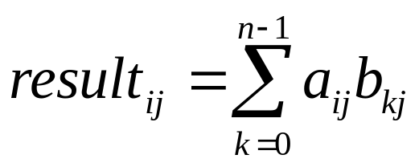
Matrix Multiplication
Definition: Given A and B, where A is mxn and B is nxp, the product matrix Result has dimension mxp. Its [i][j] element is
for 0 ≤ i < m and 0 ≤ j < p.

Slide 19
Representation of Arrays
Multidimensional arrays are usually implemented by one dimensional array via either row major order or column major order.
Example: One dimensional array
α
α+1
α+2
α+3
α+4
α+5
α+6
α+7
α+8
α+9
α+10
α+12
A[0]
A[1]
A[2]
A[3]
A[4]
A[5]
A[6]
A[7]
A[8]
A[9]
A[10]
A[11]

Slide 20
Two Dimensional Array Row Major Order
Col 0
Col 1
Col 2
Col u₂ - 1
Row 0
X
X
X
X
Row 1
X
X
X
X
Row u₁ - 1
X
X
X
X
u₂
elements
u₂
elements
Row 0
Row 1
Row i
Row u₁ - 1
i * u₂ element

Slide 21
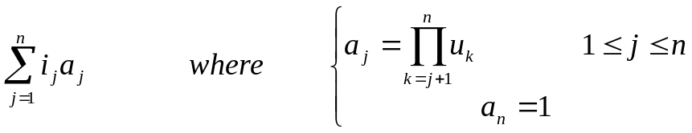
Generalizing Array Representation
The address indexing of Array A[i₁][i₂],…,[i_{n}] is
α+ i₁ u₂ u₃ … u_{n}
+ i₂ u₃ u₄ … u_{n}
+ i₃ u₄ u₅ … u_{n}
:
:
+ i_{n-1} u_{n}
+ i_{n}
=α+

Slide 22
String
Usually string is represented as a character array.
General string operations include comparison, string concatenation, copy, insertion, string matching, printing, etc.
H
e
l
l
o
W
o
r
l
d
\0

Slide 23
String Matching The Knuth-Morris-Pratt Algorithm
Definition: If p = p₀p₁…p_{n-1} is a pattern, then its failure function, f, is defined as
If a partial match is found such that s_{i-j} … s_{i-1} = p₀p₁…p_{j-1} and s_{i} ≠ p_{j} then matching may be resumed by comparing s_{i} and p_{f(j–1)+1} if j ≠ 0. If j = 0, then we may continue by comparing s_{i+1} and p₀.

Slide 24
Fast Matching Example
Suppose exists a string s and a pattern pat = ‘abcabcacab’, let’s try to match pattern pat in string s.
j 0 1 2 3 4 5 6 7 8 9
pat a b c a b c a c a b
f -1 -1 -1 0 1 2 3 -1 0 1
s = ‘- a b c a ? ? . . . ?’
pat = ‘a b c a b c a c a b’
‘a b c a b c a c a b’
j = 4, p_{f(j-1)+1} = p₁
New start matching point

